Slide 1


BIOASSAY
SETH GOVIND RAGUNATH SABLE COLLEGE OF PHARMACY
SASWAD
Mrs.Pradnya Nilesh Jagtap
HOD & Assistant Professor
PDEA’s SGRS College of Pharmacy, Saswad

Slide 2
INDEX
Defination
Principle
Application
Type of bioassay
Bioassay of oxytocin
Bioassay of digitalis
Bioassay of histamine
Bioassay of D tubocurarine
Bioassay of insulin
Bioassay of vasopressin
Bioassay of ACTH

Slide 3
BIOASSAY
DEFINATION
Detection of measurement of the concentration of substance in a
preparation using biological method .
PRINCIPLE
The basic principle of bioassay is to compare the test substance
with the international standard preparation of the same and find
out how much test substance is required to product a same biol -
ogical effect as produced by the standard.

Slide 4
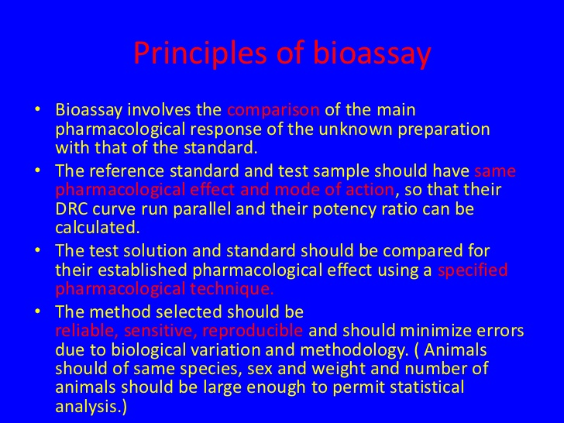

Slide 5
APPLICTION
To measure the pharmacological activity or new chemically undefined substance
To investigate the function of endogenous mediators
To measure drug toxicity and unwanted effect
To measure the concentration of drug and other active substance in the blood or other body fluids
New drug development
Major clinical effectiveness

Slide 6
TYPE OF BIOASSAY
QUALITATIVE BIOASSAY – Is used for assessing the physical effects of a substance that may not be quantified , such as abnormal development or deformity.
QUANTITIVE BIOASSAY – Involve estimation of concentration / potency of a substance by measurement of the biological response it produce.

Slide 7
METHOD OF BIOASSAY
QUANTAL
GRADED
QUNTAL BIOASSAY : In this the response is in the from all or none i.e. Either no response or maximum response.
Drug producing quantal effect can be bioassay by end point method.
GRADED BIOASSAY : Response is proportional to the dose and response may lie between number response and the maximum response.

Slide 8
Graded bioassay Types:
Graphical or Interpolation Bioassay
Matching Point Bioassay
Bracketing method / direct method
Multiple point assays
  Three point
  Four point
  Six point

Slide 9
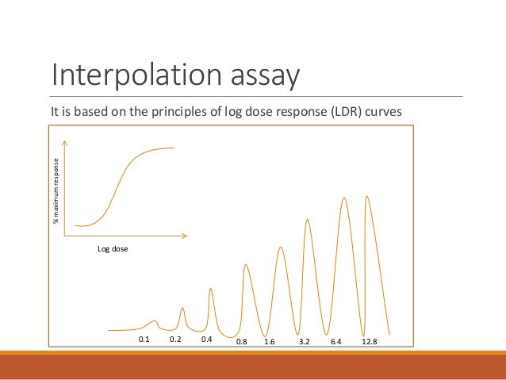
GRAPHICAL / INTERPOLATION
A log dose response curve is plotted with the standard an a simple graph paper or semi-log paper.
The concentration of the test is then read form the graph.

Slide 10
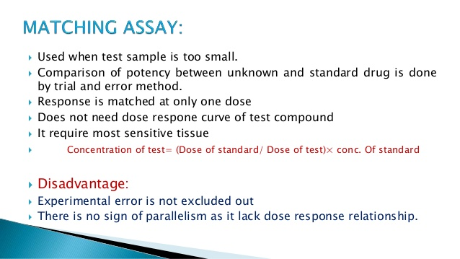

Slide 11
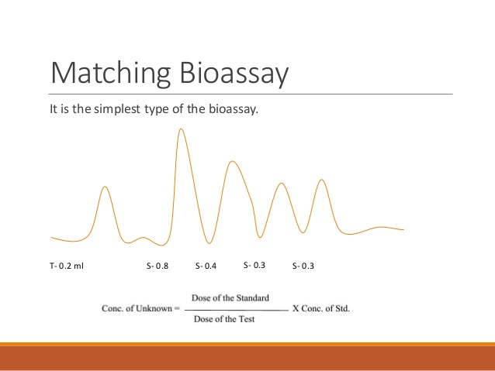

Slide 12
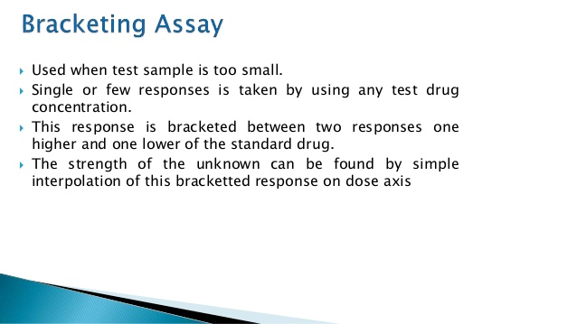
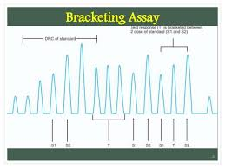

Slide 13
Multiplication point Assay
Three point method –
2 dose of standard + 1 dose of test
Four point method –
2 dose of standard + 2 dose of test
Six point method –
3 dose of standard + 3 dose of test

Slide 14
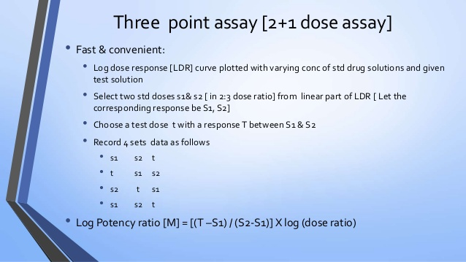

Slide 15
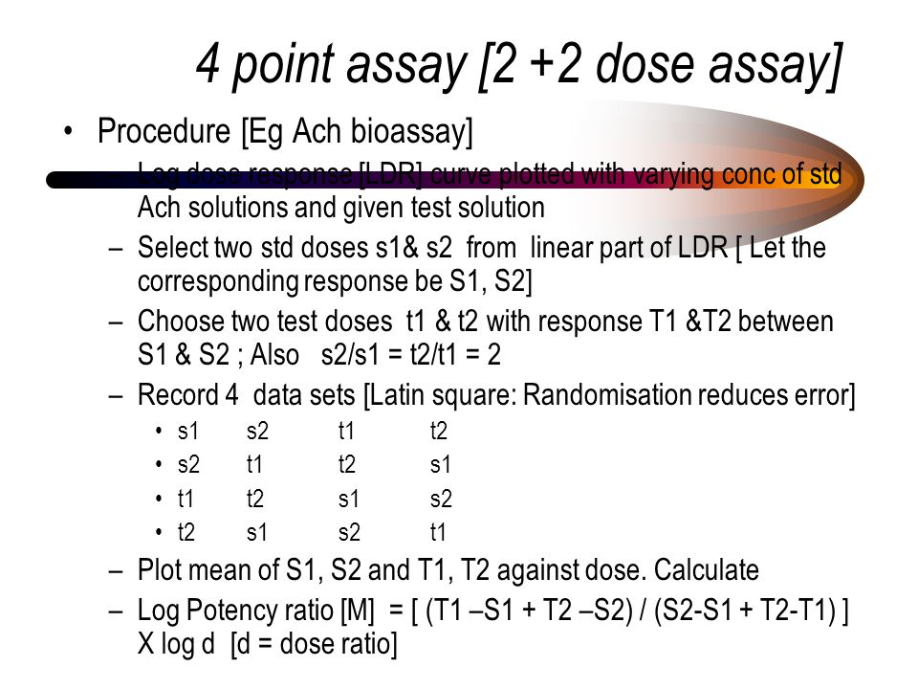
Four Point Bioassay Method

Slide 16
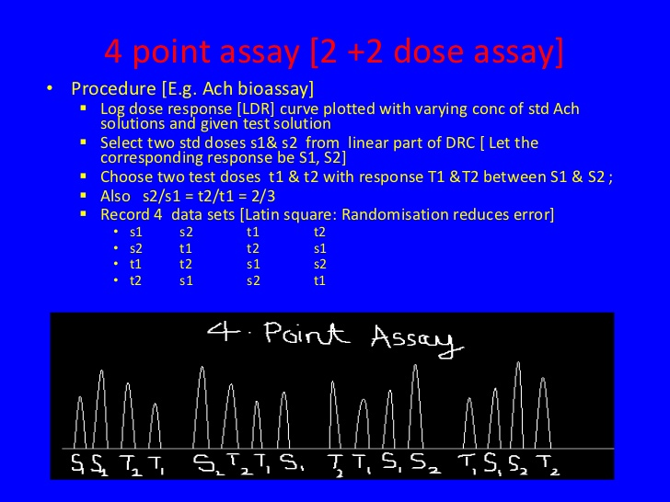

Slide 17
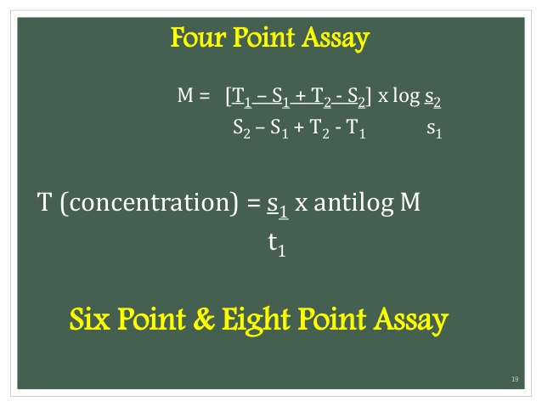

Slide 18
BIOASSY OF OXYTOCIN
Oxytocin is a peptide hormone and Neuropeptide .
Oxytocin is normally produced by the paraventricular nucleus of the hypothalamus and released by the posterior pituitary.
ROLE OF OXYTOCIN
Oxytocin is a natural hormone that causes the uterus to contract.
Oxytocin is used to induce labor or strengthen labor contractions during childbirth, and to control bleeding after childbirth.
Oxytocin is also used to stimulate uterine contraction in a woman with an incomplete or threatened miscarriage.

Slide 19
PRINCIPLE OF OXYTOCIN
Potency is determined by comparing its activity
- Depression of BP
- Contraction of uterus
- Milk Ejection Pressure
- Vasopressor activity
with standard preparation of oxytocin
STANDARD PREPARATION :
Consisting freez dried synthetic oxytocin peptide with human albumin citric acid (12.5 units)

Slide 20
METHOD –A TEST ANIMAL : COCKEREL (Young male Chicken)
Anaethesised cock – prolong and constant high B.P
Expose gluteus primus muscle and remove popliteal artery and femoral
crural vein
cannulate the popliteal artery or brachial vein
Prepare std solution with saline inject 0.1 -0.5 ml
Inject 2 dose of std solution into cannulate vein is record B.P response
Dose should cause decrease in B.P

Slide 21
Internal between 2 injection between 3-10 min depend on rate at which B.P return normal
Dil. Test preparation with saline so as to get same response as standard
The ratio between standard and test should be equal
Measure all response are calculated result of the assay by std statistical method .

Slide 22
BIOASSY OF HISTAMINE
Estimation of the concentration /potency of a substance by measuring its biological response in living system .
BIOASSY OF HISTAMINE CAN BE DONE BY RECORDING :
CRC of isolated guinea pig ileum.
BP fall in anaethetised cat or dog.

Slide 23
BIOASSY USING GAUINEA PIG ILEUM
BIOASSY OF HISTAMINE ON ISOLATED GUINEA PIG ILUM CAN BE DETERMINE BY
Matching bioassay
Interpolation bioassay
Bracketing assay
Multiple point assay

Slide 24
ILEUM
3/5 cm long part of ileum
REQUIRMENTS :
Instruments : thermo statically controlled organ bath , chymograph , aerator
Physiological solution : Tyrode solution
Temperature : 32 c
Animal : guinea pig
Standard histamine solution

Slide 25
preparing standard
Take 10 mg of histamine + 10 ml of water (1000ug / ml)
Take 0.1 and dilute with 10 ml water ( 10 ug /ml)

Slide 26
BIOASSAY USING ANAESTHETISED CAT OR DOG
Cat or dog is anaesthestised with chloralosed or barbiturate and prepared for recording of BP
Sensitivity is determined by injecting standard solution of 0.05 ,1.0 ,1.5 ug of histamine base per kg body weigh is given for 5 min interval assay is done
A fixed dose of standard producing a fall in BP about 20 mm Hg is injected with changing dose of test at regular intervals and matching assay is done

Slide 27
BIOASSAY OF DIGITALIS
· Principle: Potency of the test sample is compared with that of the standard preparation by determining the action on the cardiac muscle.
Standard Preparation and Units: The standard preparation is a mixture of dried and powdered digitalis leaves (1 unit = 76 mg.)
· Preparation of Extracts: Exact amount of the powder is extracted with dehydrated alcohol in a continuous extraction apparatus for six hours. The final extract should contain 10 ml. (5 ml. alcohol + 5 ml. water) per 10 g. of digitalis powder. It should be stored in between 5 0C and –5 oC.

Slide 28
PIGEON METHOD
o Minimum 6 pigeons are used for testing each sample.
o The weight of the heaviest pigeon should not exceed twice the weight of the lightest pigeon.
o Food is withheld 16-28 hours before the experiment.
o Pigeons are divided on the basis of their sex, weight and breed, into two groups.
o They are anaesthetized with anesthetic ether.
o One side of the wing is dissected and the alar vein is cannulated by means of a venous cannula. Dilutions are made with normal saline.
o The test sample and standard sample is infused through cannula In pigeons, stoppage of heart is associated with a characteristic vomiting response called ‘emesis’.
o The milk from the crop sac of pigeons is being ejected out. This may be taken as the end point response of digitalis. The lethal dose per kg. of body weight is determined for each pigeon.
o The potency of the test sample is determined by dividing the mean lethal dose of standard by the mean lethal dose of the test sample.

Slide 29
BIOASSAY OF D-TUBOCURARINE
Rabbit Head-drop Method :
· Principle: d-Tubocurarine hydrochloride is injected into the marginal vein of a rabbit’s ear till the rabbit’s neck muscles are relaxed such that the animal cannot hold its head up. The total amount of test sample required to produce the endpoint is compared with the total amount of the standard sample required to produce similar endpoint.
· Selection of Rabbits: Rabbits weighing 2 kg. are used. Animals should be free from disease, obtained from a healthy colony and should be accustomed with the experimental procedure.
Experimental Procedure:
- Rabbit is placed in a holder with its head protruding outside. o The head should be freely movable.
- Minimum 8 rabbits are used.

Slide 30
They are divided into two groups each containing 4 rabbits.
o First group will receive standard sample and the second group will receive the sample under test.
o d-Tubocurarine solution is injected at a constant speed by infusion apparatus through the marginal vein.
o Injection should be given at a rate of 0.4 ml/min and should take about 10 min. Dose 0.012% w/v in saline.
o Infusion is continued till the rabbit will not be in a position to hold its head erect or there will be no response by focusing light on the eyes.
o Rabbits recover immediately from the effect of curarization.
o During the experiment there is a possibility of respiratory embarrassment which is treated by injecting neostigmine, methyl sulphate (0.05 mg.) and atropine sulphate immediately through the marginal ear vein.

Slide 31
o Cross-over test is carried out to minimize biological error due to animal variation.
o Those rabbits which received the standard sample on the first day will be given test sample on the second day of experiment and vice versa.
o Mean dose which produces head drop of the test sample is compared with the mean dose of standard preparation.

Slide 32
› Insulin was discovered in 1921, which helped millions suffering from type-1 diabetes .
› It is a hormone made in pancreas, special cells call “beta cell” produce insulin…
› When a person suffer from type-1 diabetes the capability of these cells is lost…
› Most people now a days use human insulin or insulin analogs..
› Its is produced by bacteria (lilly) or by yeast (Novo-Nordisk) by using genetic engineering….

Slide 33
BIOASSAY OF INSULINE
• Standard preparation and unit: It is pure, dry and crystalline insulin. One unit contains 0.04082 mg. This unit is specified by Ministry of Health, Government of India and is equivalent to international unit.
• Preparation of standard solution: Accurately weigh 20 units of insulin and dissolve it in normal saline. Acidify it with HCl to pH 2.5. Add 0.5% phenol as preservative. Add 1.4% to 1.8% glycerin. Final volume should contain 20 units/ml. Store the solution in a cool place and use it within six months.
• Preparation of test sample solution: The solution of the test sample is prepared in the same way as the standard solution.

Slide 34
Rabbit method
› Selection of rabbits: They should be healthy, weighing about 1800-3000 gm . They should then be maintained on uniform diet but are fasted for 18 hrs. before assay. Water is withdrawn during the experiment.
› Standard and Sample Dilutions: These are freshly prepared by diluting with normal NaCl solution so as to contain 1 unit/ml. and 2 units/ml.
› Doses: The dose which can produce suitable fall in blood sugar level is calculated for the standard.
› Principle: The potency of a test sample is estimated by comparing the hypoglycemic effect of the sample with that of the std. preparation of insulin. Any other suitable method can also be used.

Slide 35
› Experimental Procedure: Animals are divided into 4 groups of 3 rabbits each. The rabbits are then put into an animal holder. They should be handled with care to avoid excitement.
› First part of the Test: A sample of blood is taken from the marginal ear vein of each rabbit. Presence of reducing sugar is estimated per 100 ml. of blood by a suitable chemical method. This concentration is called ‘Initial Blood Sugar Level’. The four groups of rabbits are then given sc. injections of insulin as follows:
12 RABBITS
3 3 3 3
standard standard test sample test sample
Dilution Dilution Dilution Dilution
(1) (2) ( 1) (2)

Slide 36
› From each rabbit, a sample of blood is withdrawn up to 5 hrs. at the interval of 1 hr. each. Blood sugar is determined again. This is known as ‘Final Blood Sugar Level’.
› Second part of the test (Cross over test) : The same animals are used for the second part. The experiment can be carried out after one week. Again they are fasted and initial blood sugar is determined. The grouping is reversed, that is to say, those animals which received the standard are given the test and those which received the test are now given the standard. Those animals which received the less dose of the standard are given the higher dose of the test sample and vice-versa. This test is known as ‘Twin Cross Over Test’.

Slide 37
RAT DIAPHRAGM METHOD
Sprague Dawley rats weighing 70–100 g are used. The animals are sacrificed during anesthesia and the diaphragms still attached to the rib cages are carefully removed, released from the rib cages and adhering connective and fat tissues, washed in PBS, spread out and divided into two equal pieces as described by Müller and coworkers (1994). For assaying the effects of insulin/compounds/drugs, the hemidiaphragms are incubated in KRH buffer gassed with carbogen (95% O2 /5% CO2) in the presence of 5 mM glucose
Epididymal fat pad of rats
› Insulin-like activity can be measured by the uptake of glucose into fat cells. Adipose tissue from the epididymal fat pad of rats has been found to very suitable.

Slide 38
› The difference of glucose concentration in the medium after incubation of pieces of epididymal rat adipose tissue or measured oxygen consumption in Warburg vessels, Radiolabelled 14C glucose, the 14CO2 is trapped and counted.
› The concentration is determined by immuno- assay

Slide 39
Bioassay of ACTH/ Adrenocorticotropic Hormone/ corticotropin
Bioassay of ACTH
 ACTH (Adrenocorticotropic hormone, corticotropin) is polypeptide tropic hormone (39 amino acids) secreted by the anterior pituitary gland.
 ACTH stimulates the production of cortisol, a steroid hormone important for regulating glucose, protein and lipid metabolism, suppressing the immune system response, and helping to maintain blood pressure.

Slide 40
Bioassay of ACTH Official Preparations
Corticotropin injection: Is a sterile solution , in a suitable diluent, of the polypeptide from the pituitary glands of mammals. Potency range should be 80.0 – 120.0 % of USP cartiotropin units.
Corticotropin for injection, antimicrobial agent.
Repository corticotropin injection is corticotropin in a sterile solution of partially hydrolyzed gelatin and is intended for subcutaneous and intramuscular use. This solution has been adopted as the reference standard for the bioassay.

Slide 41
. Packing :
Preserve in single-dose or multiple-dose containers of Type-1 glass.
Storage:
Store in cold place.
Labeling:
Injection recommends intravenous administration.
Purpose and rationale
This is a historical assay method
Administration of pituitary ACTH decrease the ascorbic acid present in the adrenals.
The depletion of adrenal ascorbic acid is a function of the dose of ACTH administered.
This relationship has been used for a quantitative assay of ACTH.

Slide 42
Procedure
Male Wistar rat (100-200 g) are hypophysectomized (pituitary gland removed by surgery) one day prior to the test.
For one test with 3 dose of test preparation and standard
Number of hypophysectomized rats required: at least 36 (preferably 60)
Solution:
Five units of test or standard dissolved in 0.25 ml of 0.5% phenol solution and diluted with 8.1 ml of 15% gelatin solution (Now 0.5 ml contain 300 mu ACTH). (Solution A)
Three ml of solution A diluted with 6 ml gelatin solution. Now concentration reduced to 100 mu ACTH/ 0.5 ml (solution B)
Again 3 ml of solution B diluted with 6 ml of gelatin solution, the resulting solution contains 33 mu ACTH/ 0.5 ml

Slide 43
Procedure Cont.,
The hypophysectomized rats are randomly distributed in to six groups. Each rat receives subcutaneous 0.5 ml of the various concentrations of test or standard.
Three hours after injection, the animals are anesthetized and both adrenals removed, freed from extraneous tissue and weighed. The rats are sacrificed and the scull opened to verify completeness of hypophysectomy.
The adrenals are homogenized in glass tubes contains 200 mg pure sand and 8.0 ml of 4% trichloroacetic acid and the ascorbic acid determined..
The potency ratio including confidence limits is calculated with the 3 + 3 point assay.

Slide 44
Ascorbic acid determination Reagents
 0.02% ascorbic acid solution
85 % sulfuric acid (9N H2SO4 )
0.02 g/ml of dinitrophenolhydrazine in 9N H2SO4
0.06 g/ml of thiourea are dissolved in distilled water
Charcoal
Preparation of 0.02% ascorbic acid solution
100 mg L-ascorbic acid are dissolved in 100 ml of 4% trichloroacetic acid (1mg/ml solution) (Solution A= 1 % solution)
2 ml of Solution A diluted in 10 ml of 4% trichloroacetic acid to achieve a 0.2% ascorbic acid solution (solution B)
1 ml of solution B diluted in 10 ml of 4% trichloroacetic acid to achieve a 0.02% ascorbic acid solution (solution C)

Slide 45
Preparation of other solutions
- Sulfuric acid (85%) is obtained by adding 900 ml concentrated sulfuric acid to 100 ml distilled water.
- Two g dinitrophenolhydrazine are dissolved in 100 ml 9 N H2SO4 (75 ml distilled water and 25 ml concentrated sulfuric acid).
- Six g thiourea are dissolved in 100 ml distilled water.
Calibration
- Trichloroacetic acid (4%) is added to 0.0, 0.5, 1.0, 2.0, 3.0, 4.0, 6.0, 8.0 ml of the 0.02% ascorbic acid solution (solution C) and 1.0, 1,5 and 2.0 ml of the 0.2% ascorbic acid solution to reach a final volume of 8.0 ml (Solution B).
-100 mg charcoal is added to each sample and thoroughly mixed by shaking for 1 min. After 5 min the solutions are filtered.
-An aliquot of 0.1 ml of the 6% thiourea solution is added to 2.0 ml of the filtrate followed by 0.5 ml dinitrophenylhydrazine solution.

Slide 46
The mixture is shaken and heated for 45 min at 57°C in a water bath.
Calibration cont.,
The solutions are placed in an ice-cold water bath and with further cooling 2.5 ml of the 85% sulfuric acid are added.
The calibration curve is established at a wave length of 540 mm using the solutions without ascorbic acid as blank.

Slide 47
Corticotrophin Injection USP
 Various dilutions of standard and test ACTH is prepared at geometric series such as 1:2:4 or 1:3:9 at the rage of 10 to 300 milli-units.
 Either gender of rats (weighing 80- 180 g) is used for the experiment. Rats are divided into six groups of each six and three groups assigned for standard and other three groups in test
 Prior (48h) to the injection of ACTH, animals are anesthetize and remove the hypophysis.
 All the animals are given subcutaneous injection of assigned standard/ test ACTH injection. Three hours after injection, rats are anesthetized, both adrenal glands are removed, weighted, stored in metaphosphoric acid solution for determination of ascorbic acid.

Slide 48
BIOASSY OF VASOPRESSIN
Its is a peptide hormone that is secreted by the posterior lobe of the pitutary gland , which constrict blood vessels , raise blood pressure ,stimulates intestinal motility , and reduce the excretion of urine.
Its has vasopressor action i.e can stimulate contraction of arteries and capillaries . Hence the name vasopressin
STANDARD PREPARATION
It is a dried acetone extraction of posterior lobes of pituitary gland oxen or other suitable preparation
Standard unit : Specific pressor activity corresponding to the yielded by 0.0005 gm of standard preparation (20 units /ml )

Slide 49
METHOD
Anaesthetize healthy cat with volatile anaesthetic agent
Insert a tracheal tube for artificial respiration
Expose spinal cord from behind by removing second cervical vertebrae
Destroy brain by passing suitable instrument through foramen magnum
Start artificial respiration through tracheal tube and leave animal for an hour to remove anaesthetic effect
Cannulate carotid artery for B.P measurement and femoral vein for injection of drug solution
Maintain normal B.P at 50-100
Select dose of test and standard inject 0.05 -0.1 units at 30 min. interval
Record maximum rise B.P .IN response to each dose

Slide 50
THANK YOU

